Slide 1

Certification VS Accreditation
What is the difference and why does it matter?
Certification standards, such as the ISO 9000 series, are written around compliance and the assurance that outcomes meet specific requirements.
Accreditation standards, such as ISO 17025, are written around competence in the compliance with specific requirements to produce reliable results.

Slide 2




National bodies

Slide 3
Hierarchy of bodies in Australia and New Zealand
MRA
JAS-ANZ
NATA
Certification Bodies
Our programs
Product Service or People
Accreditation Body
Conformity Assessment Body

Slide 4

CERTIFICATION
Certification is a form of Conformity Assessment [CA] and is undertaken by Conformity Assessment Bodies [CABs], known as Certification Bodies
The provision by an independent body of written assurance (a certificate) that the product, process, service, or system in question meets specific requirements.

Slide 5
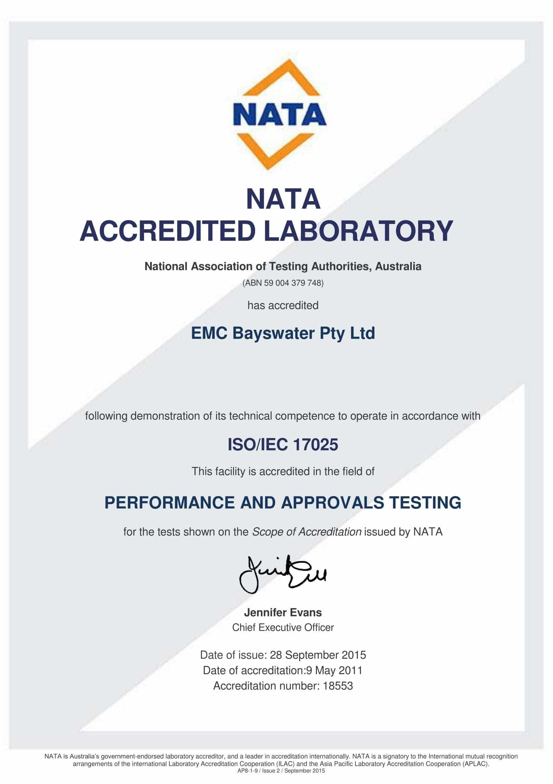
ACCREDITATION
Third-party attestation related to a conformity assessment body conveying formal demonstration of its competence to carry out specific conformity assessment tasks.
Accreditation is undertaken by Accreditation Bodies.

Slide 6


What’s the
difference?
Compliance with requirements
vs
Demonstration of competence
Notes:
What is the difference?
Compliance with requirements vs Demonstration of competence

Slide 7

The standards employed for certification and accreditation are specifically written for those purposes.

Slide 8

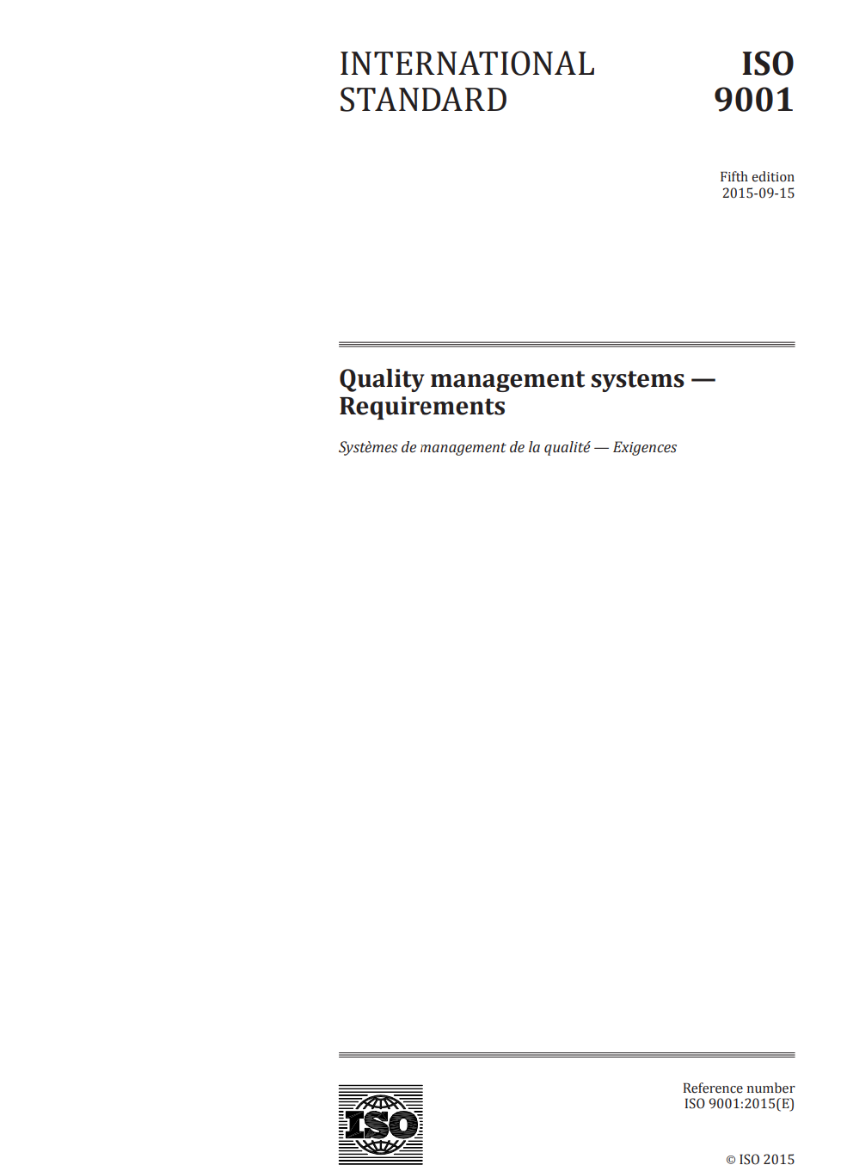

The standards employed for certification and accreditation are specifically written for those purposes.
Certification “Formal recognition that a product or service is in conformity with specific standards or technical specifications”
(ISO/IEC 17000)

Slide 9

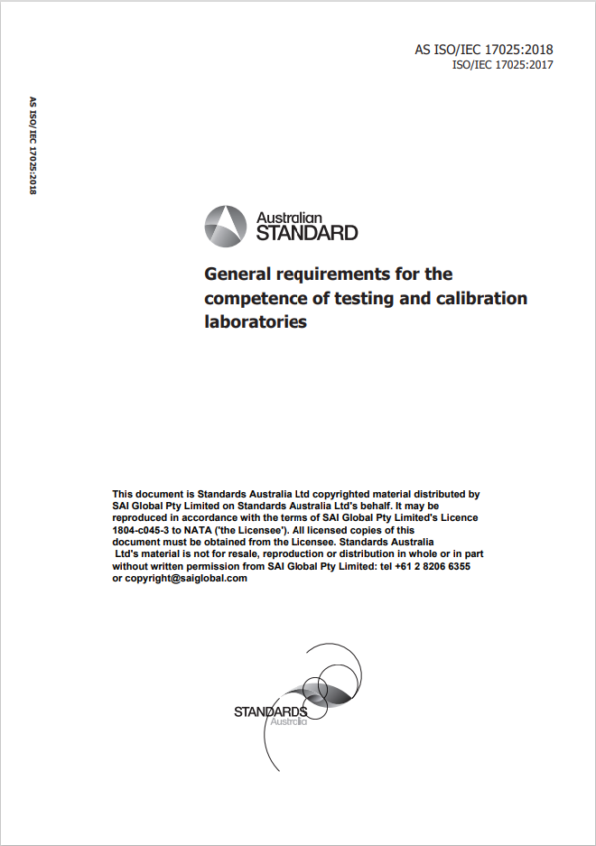
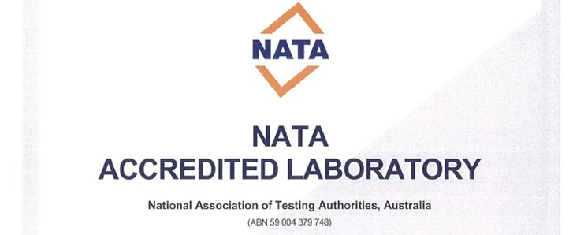
Accreditation standards, such as ISO 17025, are written around competence in the compliance with specific requirements to produce reliable results.

